Slide 1
Halloween Suites
Ecommerce website
P-Number

Slide 2
INtroduction
Ecommerce refers to the purchasing or buying and selling of tangible goods and as well as services by means of the internet, with financial and information transfers involved for the completion of these transactions.
The definition includes business to business and business to consumer transactions
The Halloween Suites application is going to be associated or involved with the selling of Halloween suites online, an economic transaction enabled by the internet employing a Business to Consumer Model ,B2C
B2C – This model incorporates theassociation between consumers and businesses . The main idea goal for this business model is to sell goods and services to consumers online using the internet. B2c refers to business-to-consumer transactions. It offers internet direct sales.
Main users of the application system
Customers (Users) - Normal users of the application
Admin - Main manager of the application
4. Technology employed on the web application
Front-End ; Html5, Css, Javascript, Bootstrap Framework.
Back-End ; C# , SQL Server.

Slide 3

User Requirements
Requirements :
Customer make /registration on the halloween suites website
Clients or Customer the login to to view Halloween suites.
Business provides Halloween Suites goods/products (Admin represents business)
Customer makes order for the product he or she likes.
Customer make payment
The order is then processed

Slide 4
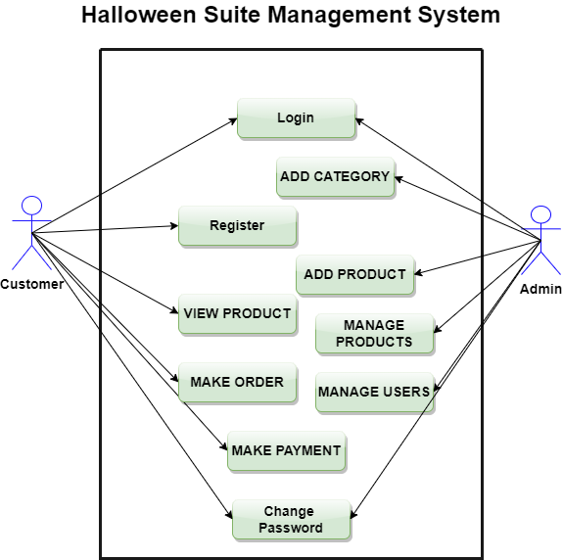
Use-case Diagram
The behavior diagram, often referred as a use case diagram, is often used to describe how all users of a system behave. All of the participants in the use scenario are actors, and the functionality is a system action.

Slide 5
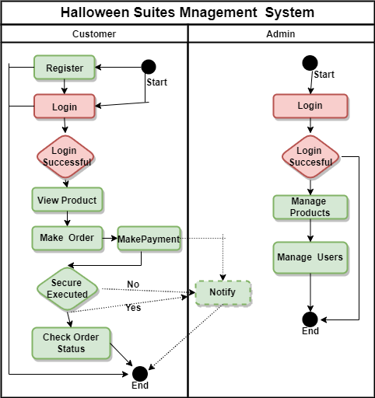
Sequence Diagram
It's a form of interacting diagram that shows how a group of items interact in a specific order. In a single use scenario, they simulate object interactions. They demonstrate how various components of a system engage to accomplish a function, and also the sequence under which these events happen when a certain use case is conducted. Because it illustrates the association logic between both the objects in the system as in order in which they occur, the sequence diagram is useful.

Slide 6
Class Diagram
The functions and qualities of a class, and the system's constraints, are depicted using a class diagram. The Class diagrams is the only UML diagrams which may be directly linked to object-oriented languages, hence they're often used in object-oriented system design.

Slide 7
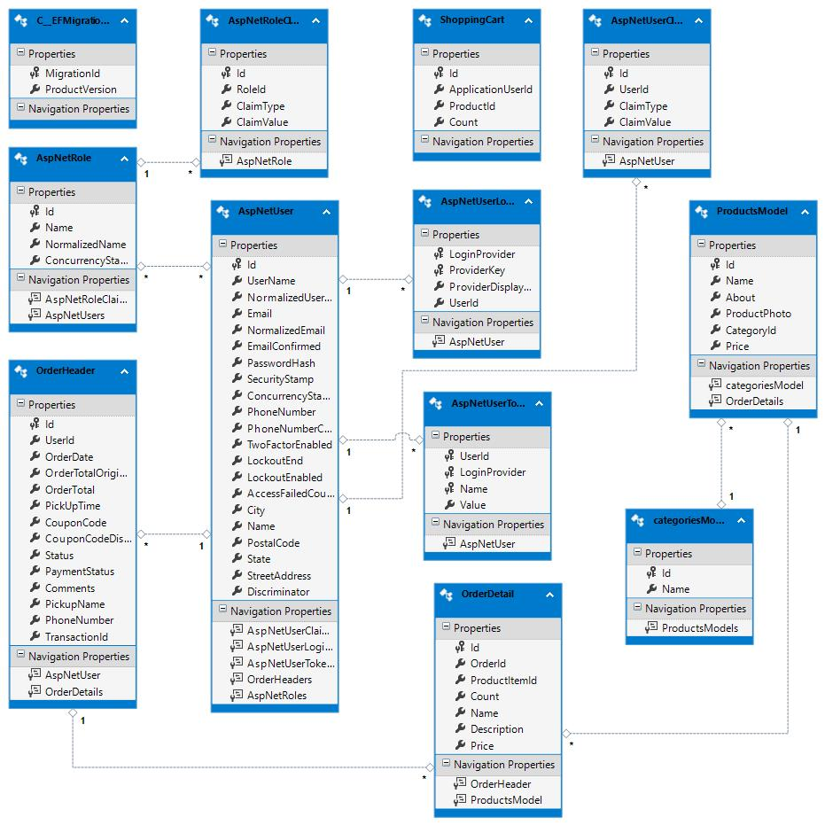
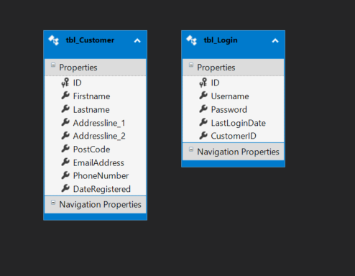
Entity relationship Diagram
In information technology system, Entity-relationship diagram depicts the relationships that is there between places, people, concepts, events and objects . An ERD is a relational database that serves as the foundation for the development of business processes. Entity relationship diagrams have been used to represent database design and create the information requirements for the system as the project advances.

Slide 8
Advantages
DISAdvantages
Results to quick selling and buying processes, and faster product discovery.
Selling and Buying are available and done at any time.
Enables reaching of many clients at the same time
There is decreased operating expense/costs with best service quality.
Customers can simply choose products from many sources without having to physically move around.
Customers are taken advantage of by several bogus websites.
Product quality cannot be guaranteed.
Occurance of mechanical failures have unforeseeable ramifications for the whole operation.

